Slide 1

payroll data, workplace equity,
& human resources
sean ayoub

Slide 2
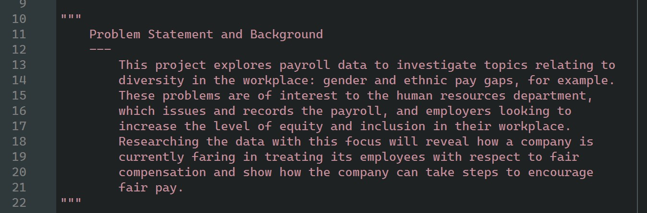
problem statement & background

Slide 3
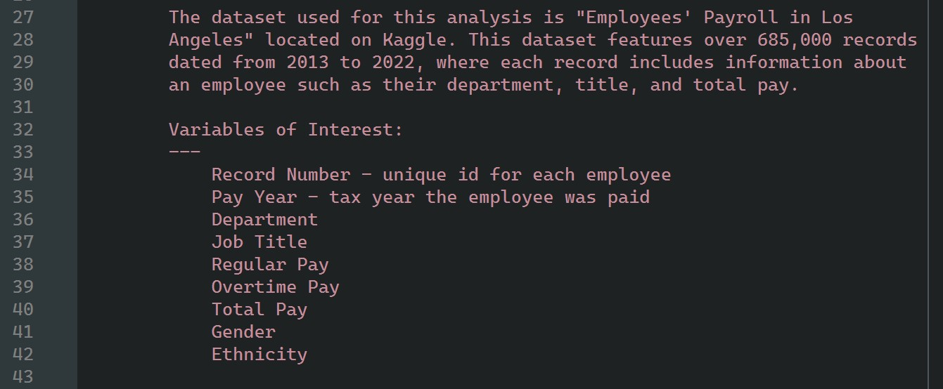
the dataset

Slide 4
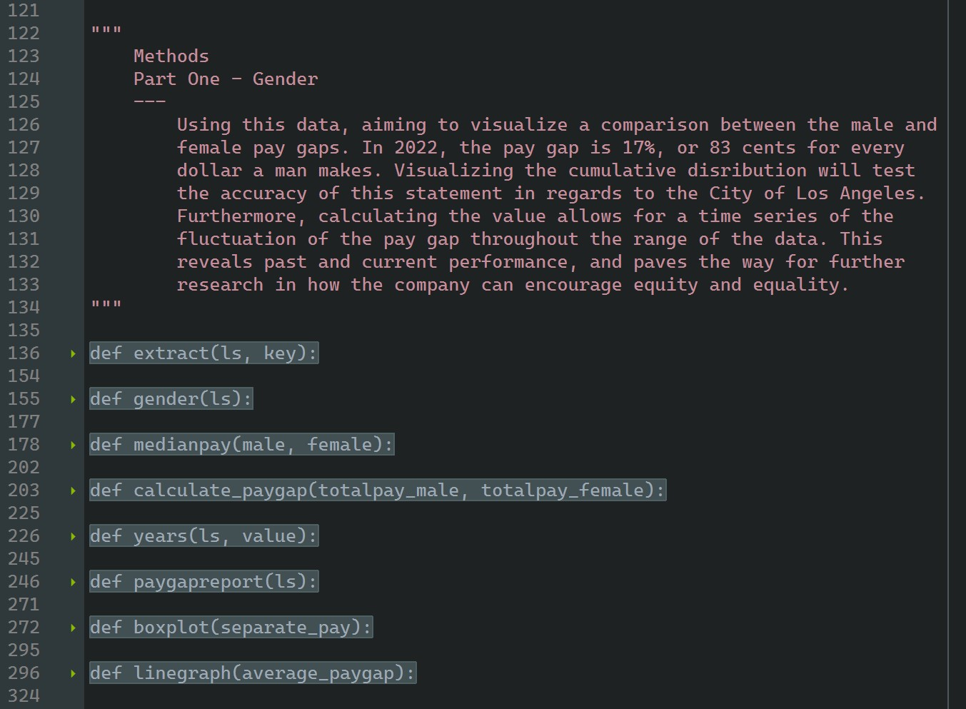
part one: gender
methods

Slide 5
context
5%
84%
42
of men said they had earned less than a woman for doing the same job
in 2020, women earned 84% of what men earned
based on this figure, it would take an extra 42 work days in the year for women to earn what men did

Slide 6
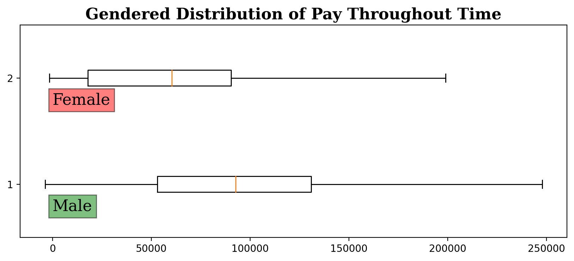
boxplot
medians // pay gap
woman's median pay:
$60444.88
man's median pay:
$92627.45
median pay gap:
35 cents per dollar. or, women earned roughly 65% of what men made

Slide 7
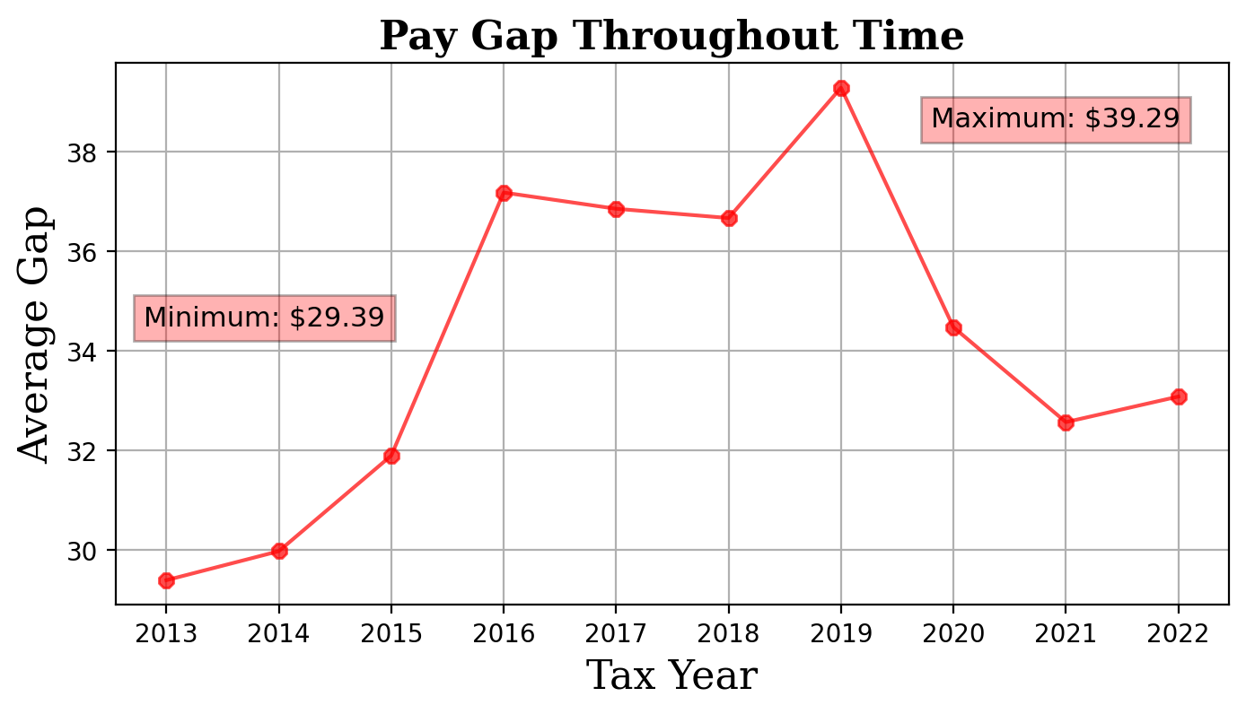
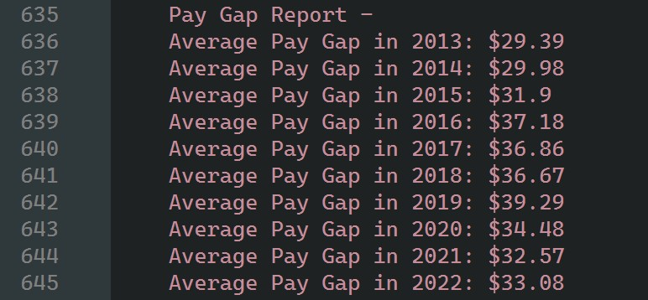
time series
how does the average pay gap change from year to year?

Slide 8
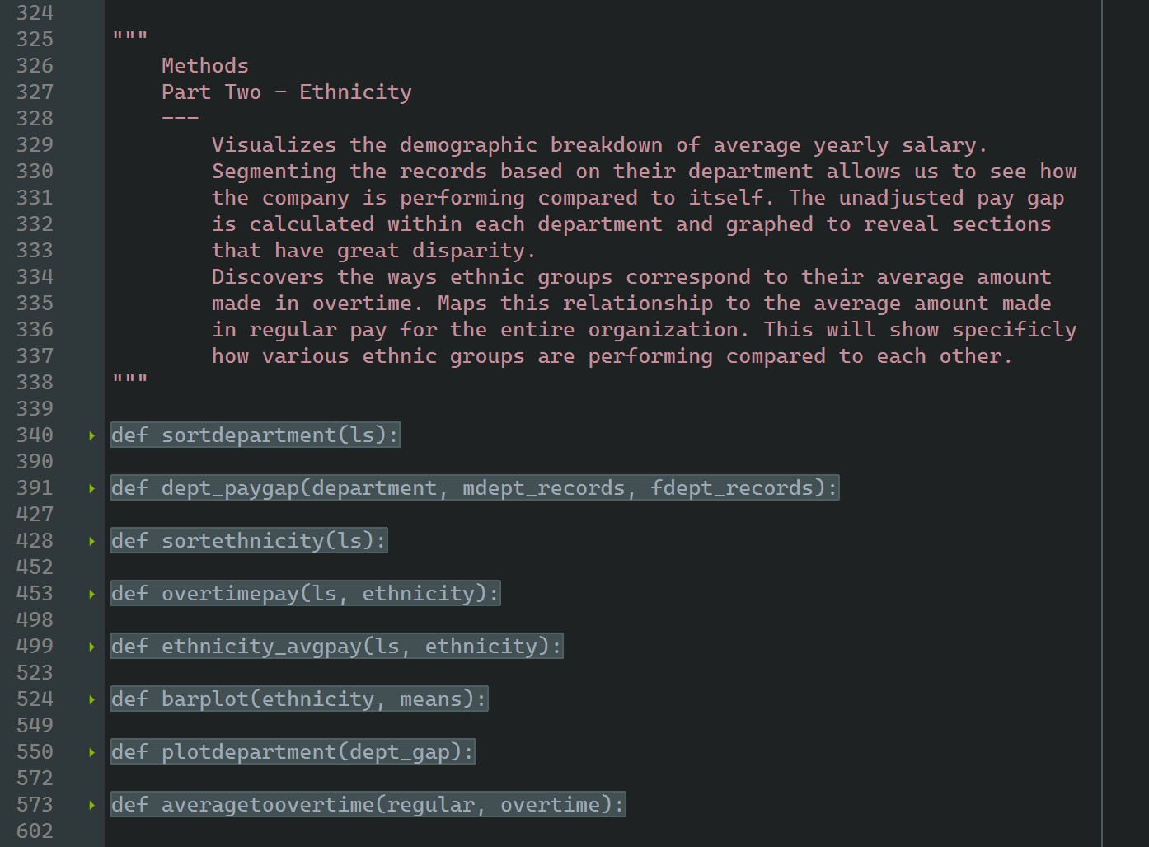
part two: ethnicity
methods

Slide 9
context
33%
in 2015,
54¢
of the workforce is comprised of white men, the largest demographic group
white men had higher hourly earnings than all other categories except asian men
latin women earn just 54 cents for every dollar paid to a white man

Slide 10
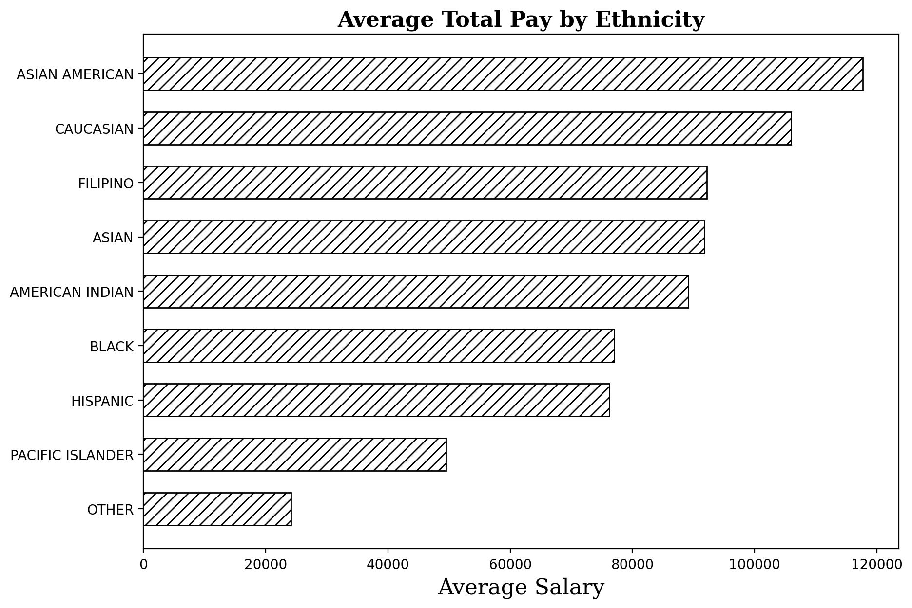
horizontal bar graph
what is the average salary that each ethnic group earns?
asian americans have a higher average salary than caucasians, which is consistent with the previous figure
---
range between highest and lowest averages:
asian american - $117703.5
pacific islanders - $49511.47
range between means - $49511.47

Slide 11
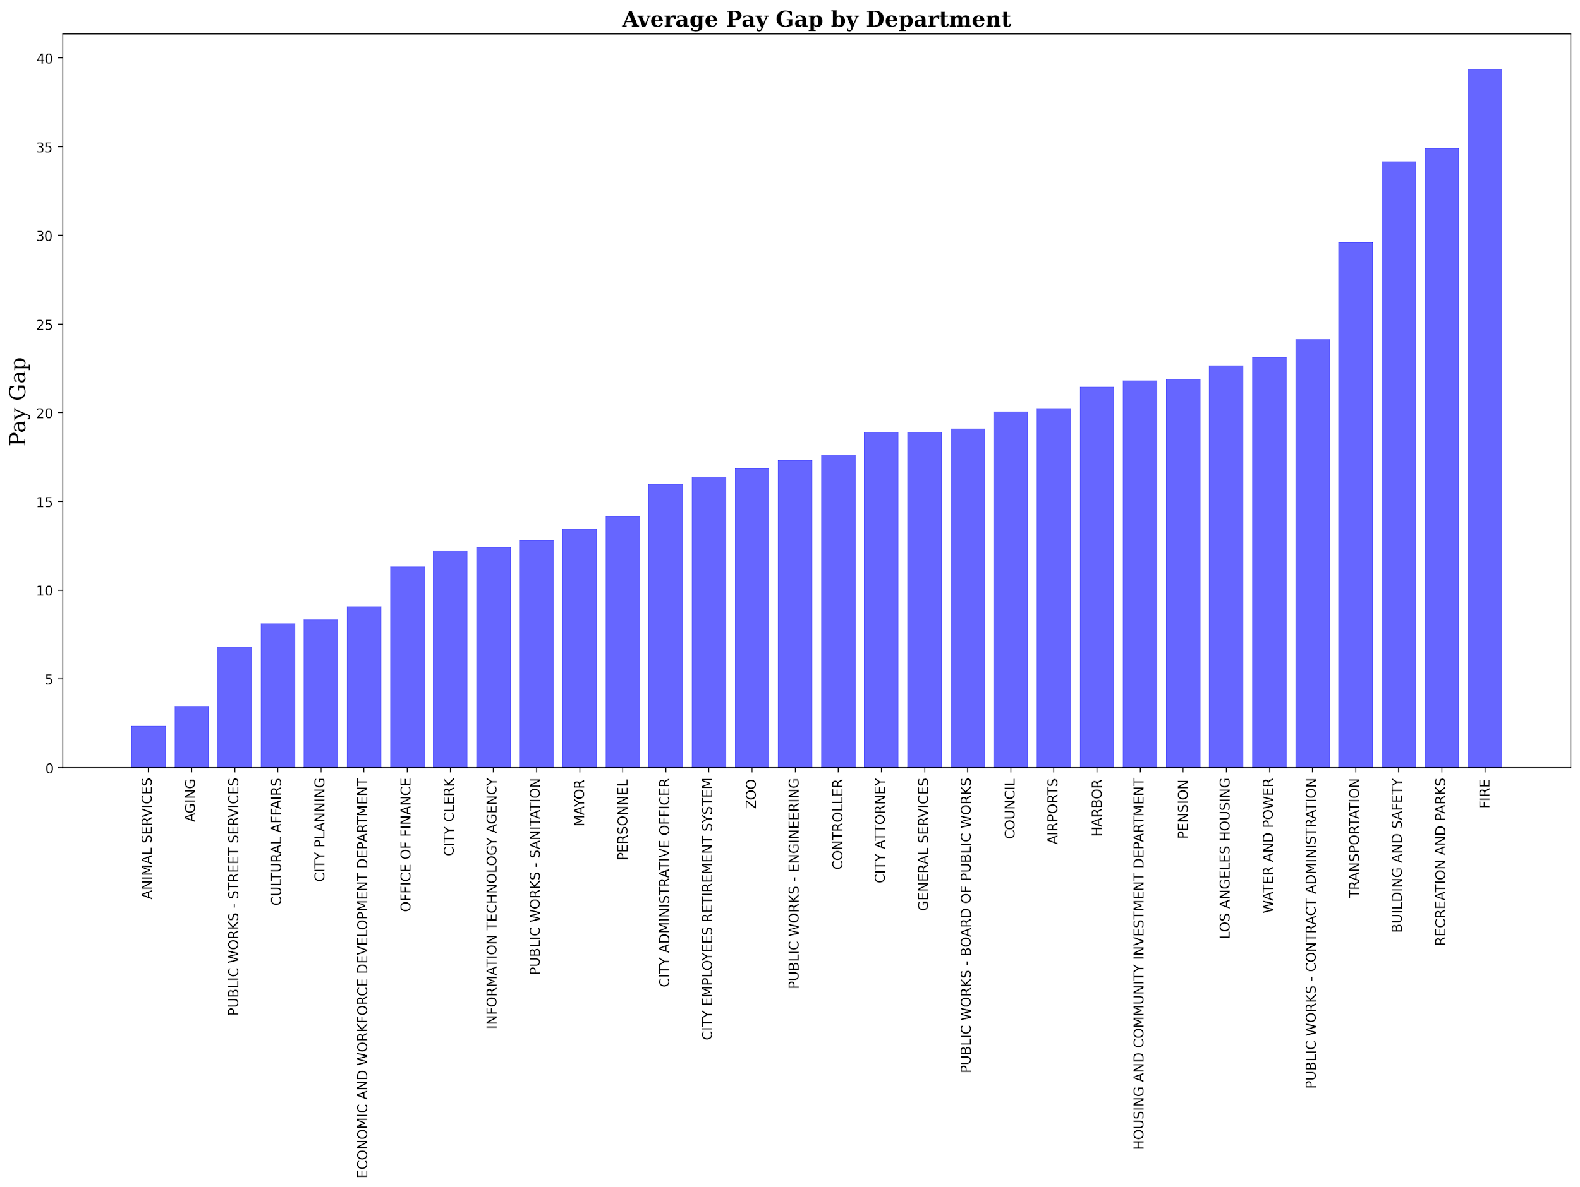
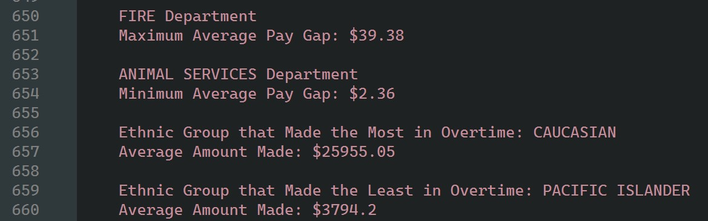
bar plot
which department has the largest pay gap? smallest?
what may be causing the difference?
out of the 534 occupations tracked by the bureau of labor statistics, only seven pay women more than men on average
much of the difference can be explained by the fact that men and women tend to work in different fields

Slide 12
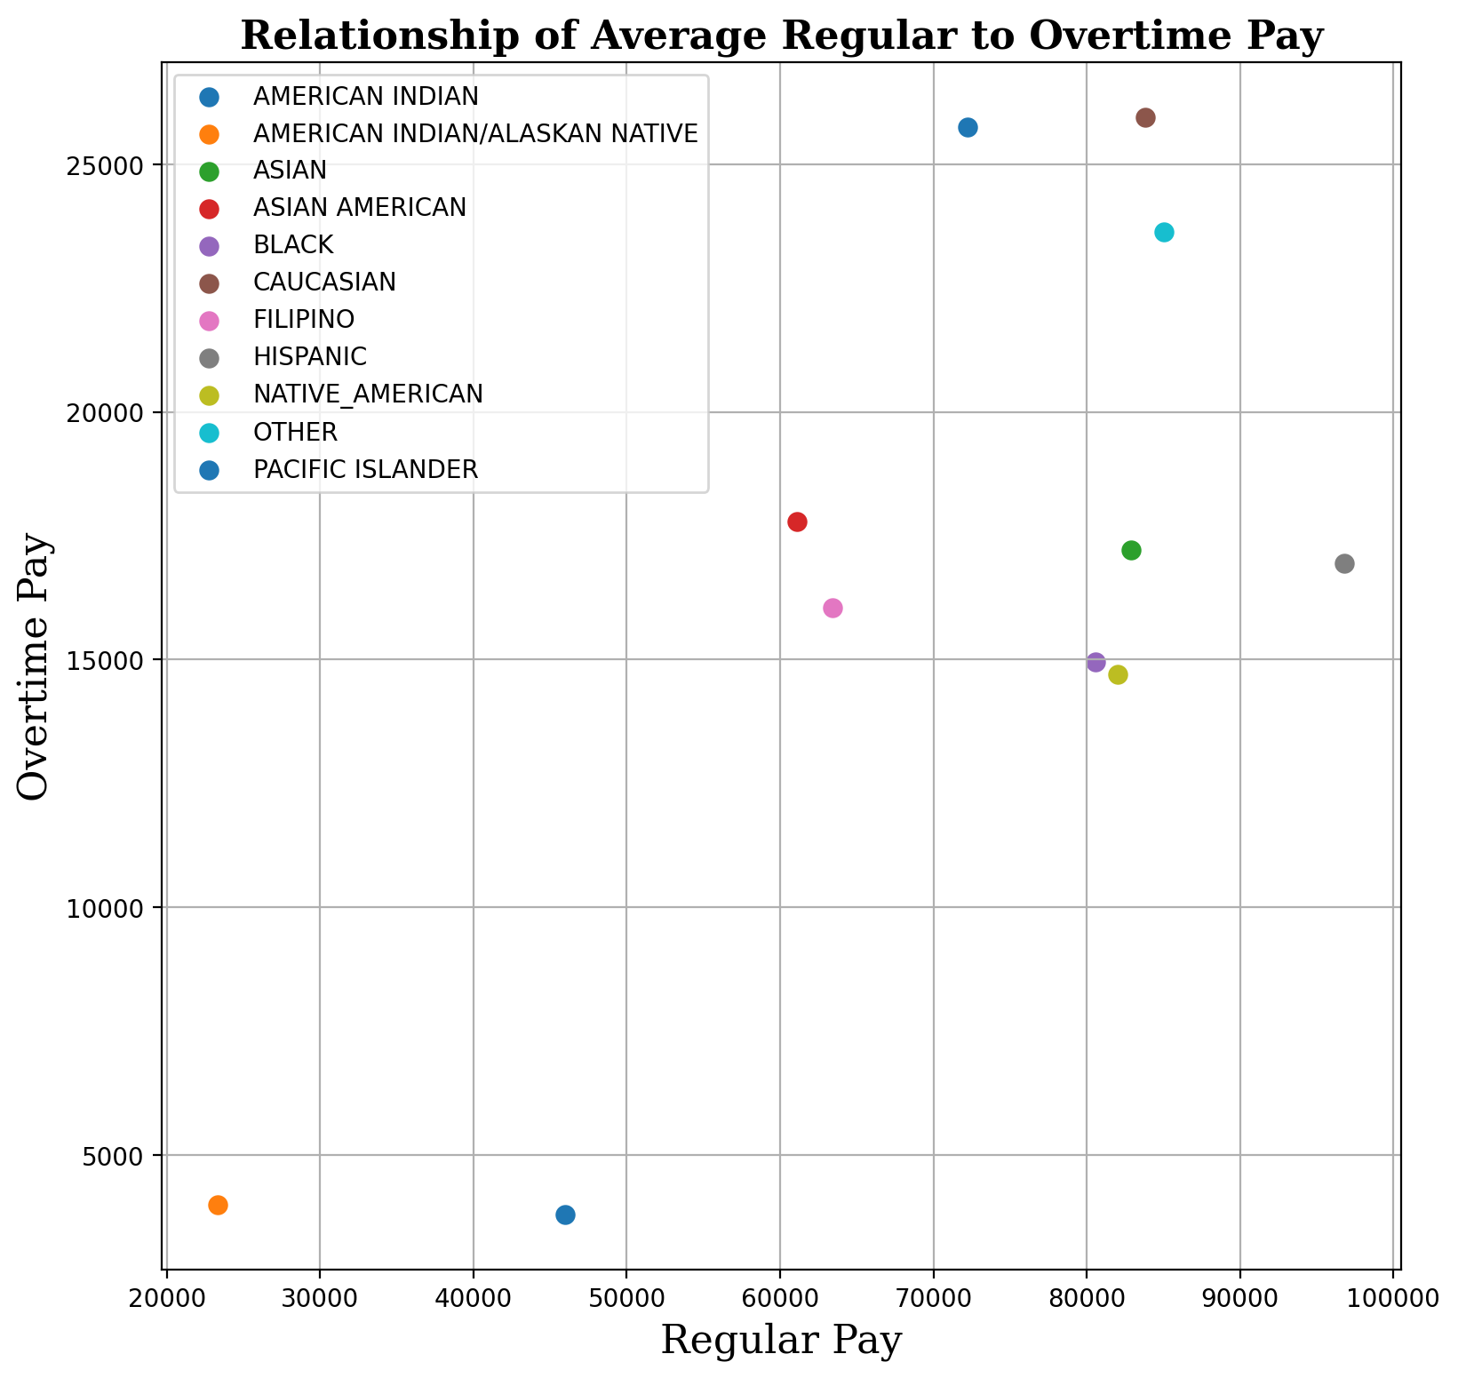
scatterplot
which ethnic groups earned the most overtime pay?
encouraging equity/fair pay
the difference in average overtime earnings may be indicative of an opportunity gap
the human resources department can redevelop their pay policies and overtime procedures to allow equal opportunity for employees across departments

Slide 13
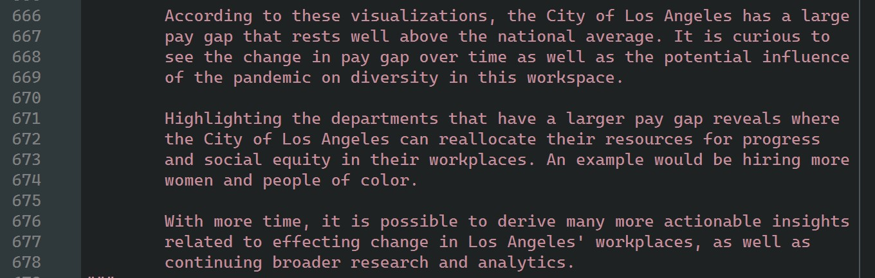
results, conclusion, & future work

Slide 14
references
www.kaggle.com/datasets/dsfelix/employees-payroll-in-los-angeles
https://www.pewresearch.org/fact-tank/2021/05/25/gender-pay-gap-facts/
https://www.americanprogress.org/article/explaining-the-gender-wage-gap.
https://www.pewresearch.org/fact-tank/2016/07/01/racial-gender-wage-gaps-persist-in-u-s-despite-some-progress/
https://www.nationalpartnership.org/our-work/resources/economic-justice/fair-pay
https://www.shrm.org/hr-today/news/hr-magazine/spring2020/pages/importance-of-pay-equity.aspx

Slide 15
thank you

